Slide 1


TRIP PLANNER
By Toronto Coders

Slide 2
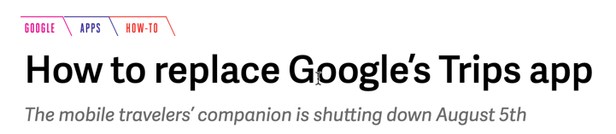


Slide 3
Feature List
Sl No | Feature | Release
1 | Search for Low Fare flights | Pilot
2 | Search for Points of Interest in Destination | Pilot
3 | Register and save favorite trip | After VC funding ☺
4 | Track price history | After VC funding ☺
5 | Book your flights and attractions | After Google buys our app
6 | Check-in and store Boarding passes | After Google buys our app

Slide 4

Thank You!
someone@Example.com

